Slide 1


Annual Members & Casual Riders
Cyclistic Bike-Share
Presented By: Ricky Ratliff
Last Updated: June 30th, 2026

Slide 2
Content Overview
1
2
3
Purpose Statement ( What are we discussing?)
The Story ( With Data)
Conclusion
4
Appendix

Slide 3
So, what are we discussing ?

Slide 4
Identify behavioral differences between annual members and casual riders to support a marketing campaign aimed at converting casual riders into members.
Objective

Slide 5
The Data

Slide 6
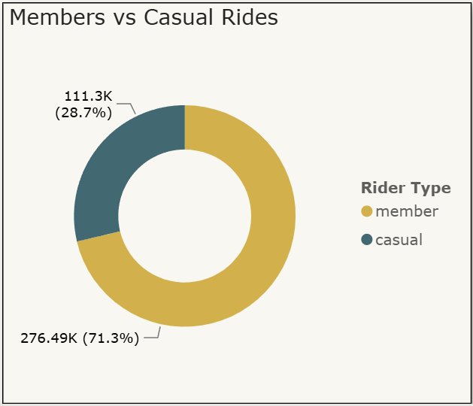
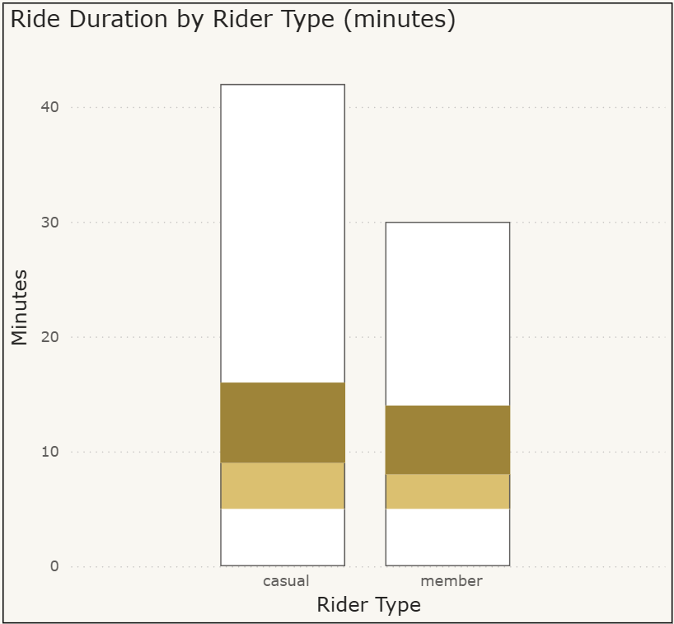
General Comparison:
Annual Members vs. Casual Riders
Total Riders:
In Total: 387.79K Riders
Annual Members: 71.3% (276.49K)
Casual Riders: 28.7% (111.3K)
Duration
Mean: Median:
Annual Members:
13.21 min 8.22 min
18.18 min 9.28 min
Casual Riders:
Key Takeaway:
Casual riders consistently take longer trips.
The box plot for casual riders is wider, meaning casual riders have more variability in how long they ride.
So What?
This can help shape our marketing message.
Notes:
"This suggests casual riders are using Cyclistic differently — likely for leisure or one-off trips — while members show tighter, more consistent durations, consistent with routine commuting. That distinction is useful for marketing: messaging that emphasizes convenience and cost savings for frequent, predictable trips could be the hook that converts casual riders into members."

Slide 7
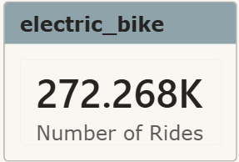
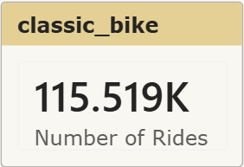
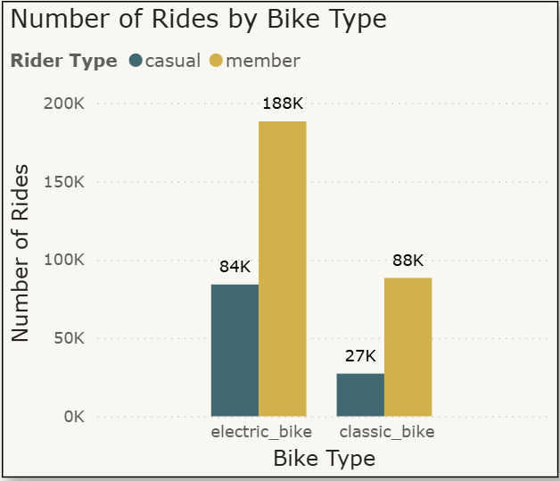
Bike Types
Rider Preference:
Annual Members: 69.1% prefer Electric Bikes
Casual Riders: 76.5% prefer Electric Bikes
Key Takeaway:
Both groups favor electric bikes but members are the the majority.
So what?
It may beneficial to promote electric bike access/pricing in membership messaging.
Notes:
Suggesting that marketing should highlight electric bike availability as a member perk, not just a casual draw, would be great since it's already the preferred bike type for both audiences.

Slide 8
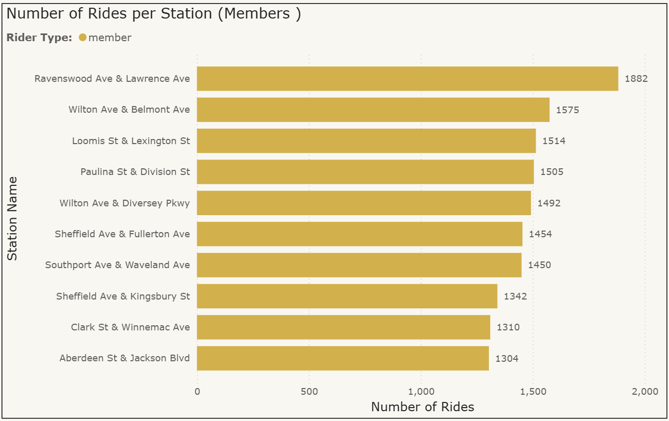
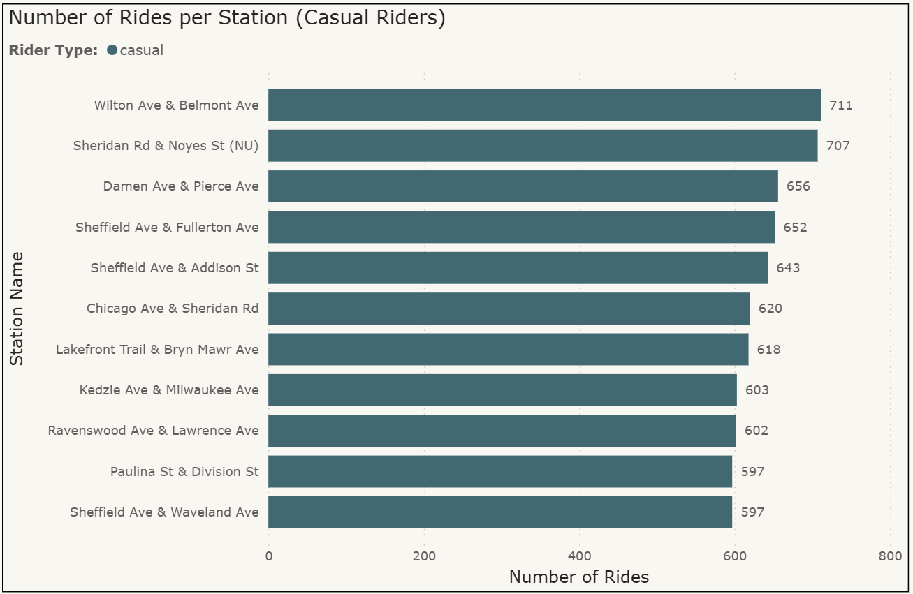
Station Popularity
Top 10 Stations
The annual members list and the casual riders list differ.
Interesting Trends
There are stations that appear on both lists.
So what?
If we use the overlap in popularity as an indicator, then we can determine which stations to target.
Notes:
Stations like Lakefront Trail & Bryn Mawr Rd (directly on the lake trail), Sheridan Rd & Noyes (Sheridan Road runs directly along the lake) , Chicago Ave & Sheridan(also runs along the lake), Sheffield Ave & Addison ( near Wrigley Field, a few blocks from the lake), Sheffield Ave & Fullerton (near Lincoln Park), and Wilton ave & Belmont (near Lincoln Park/few blocks away from the lakefront path). What do they have in common — they sit along recreational corridors — like lakefronts, bike paths, parks, scenic routes all suggesting possible leisure or recreational use based on station location
Wilton Ave & Belmont, Sheffield Ave & Fullerton, Ravenswood Ave & Lawrence , Paulina St & Division St are strong candidates for on-site membership conversion messaging."

Slide 9
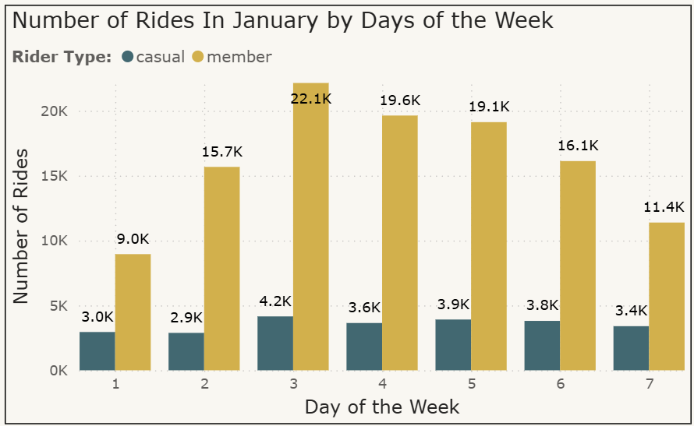
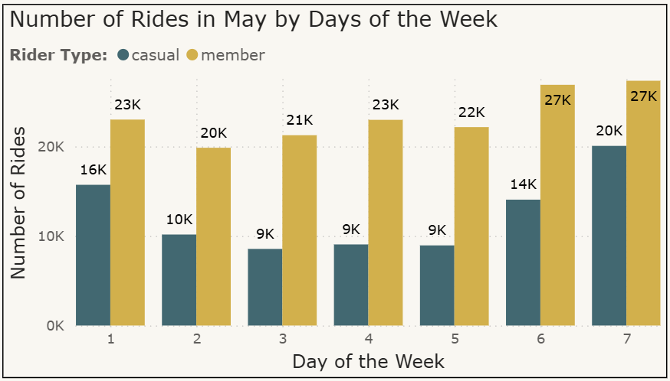
Seasonal Comparison
January
Rides peak midweek for members suggesting classic commuter pattern
Casual rides stay consistently low
May
Rides increase across the board
Members rides remain high during the week but also increase greatly over the weekend
Causal Riders greatly increase weekend rides
So What?
Winter may not be the best time for converting casual members
Summer is the better option for marketing opportunities
Notes:
Member and Casual Rider data suggest they favor warmer months. Marketing should ramp up during summer months to capitalize on the surge of riders.

Slide 10
Conclusion

Slide 11
Conclusion
Actionable Insight 1
Actionable Insight 2
Actionable Insight 3
Actionable Insight 4
Since casual rider tend to use Cyclistic for leisure and annual members lean more towards commuting, messaging that emphasizes convenience and cost-savings for frequent, predictable trips could be the hook that converts casual riders into members.
Electric bikes are the preferred bike type suggesting that marketing should highlight electric bike availability as a member perk, not just a casual draw.
Based on shared popularity by both rider types Wilton Ave & Belmont, Sheffield Ave & Fullerton, Ravenswood Ave & Lawrence , Paulina St & Division St are strong candidates for on-site membership conversion messaging.
Based on rising demand during warmer season, marketing should ramp up during summer months to capitalize on the surge of riders.

Slide 12
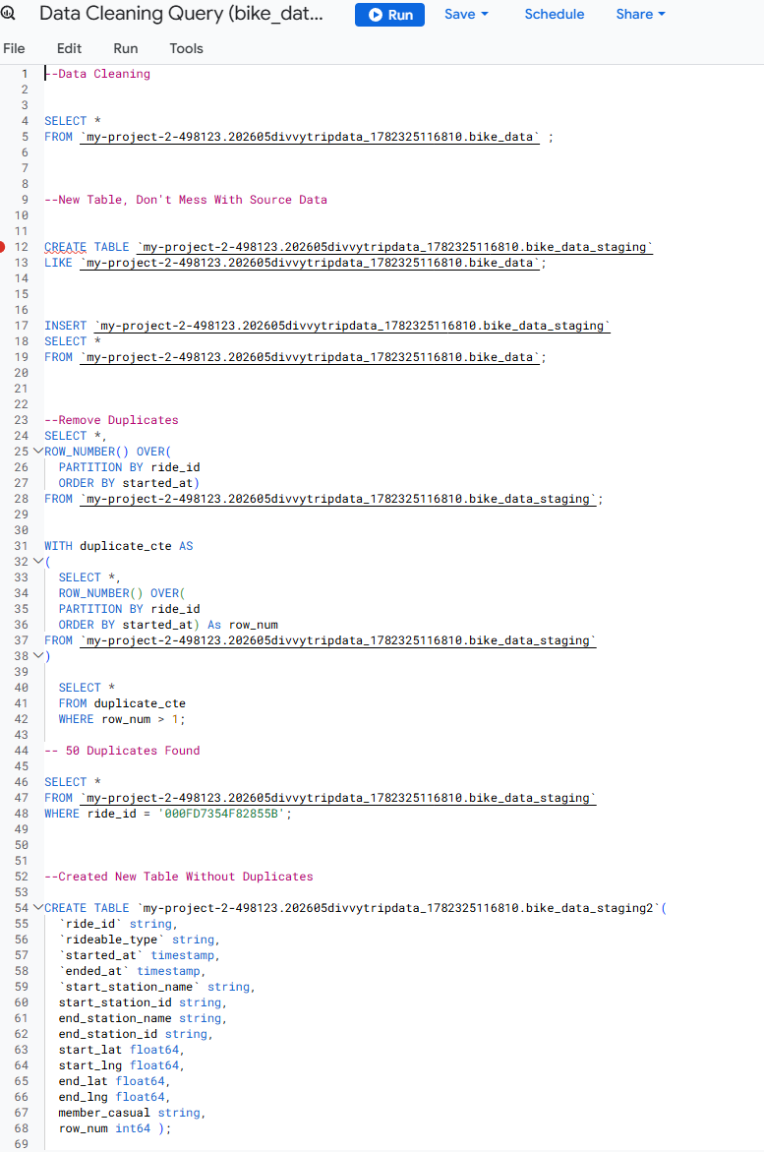
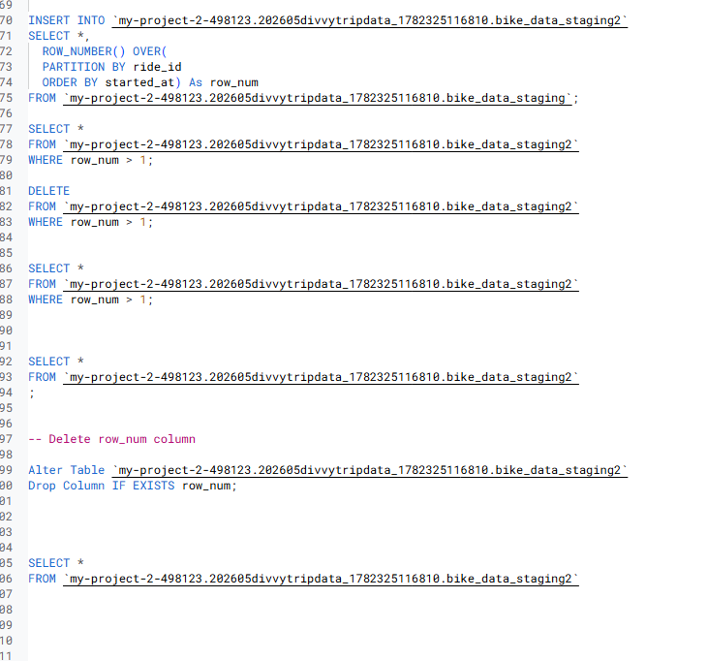
Appendix

Slide 13
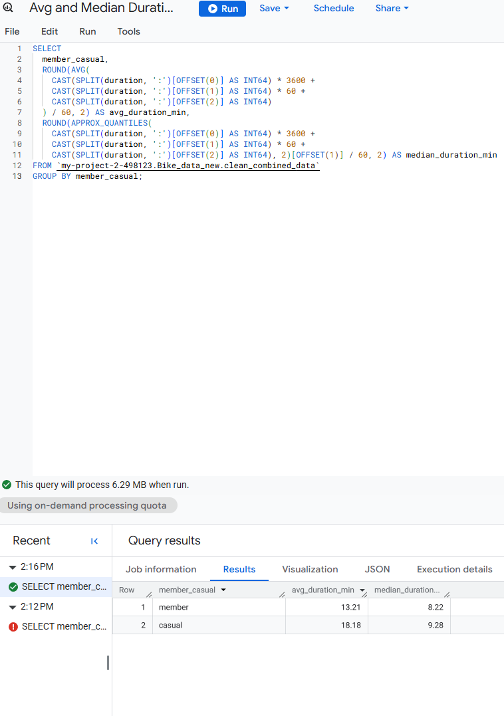
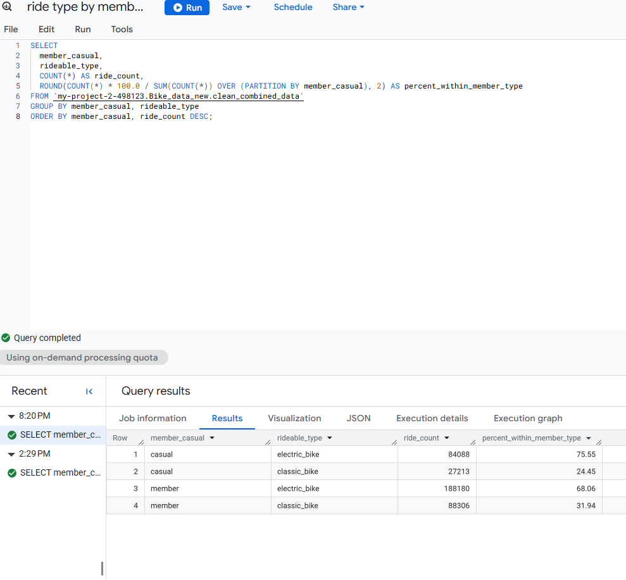
Appendix (Continued)

Slide 14
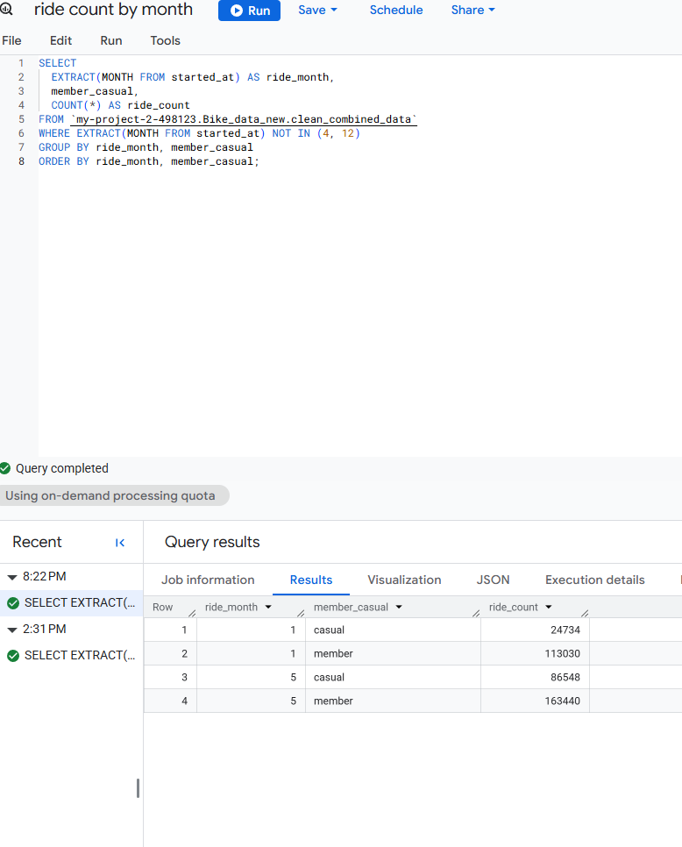
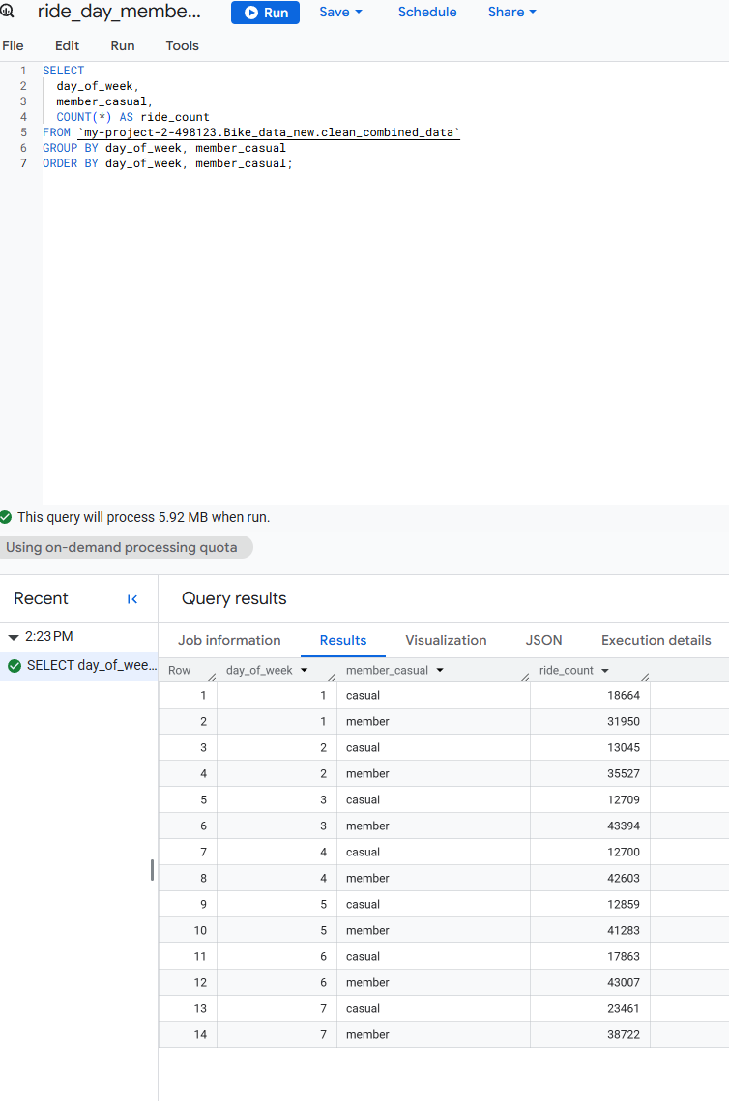
Appendix (Continued)

Slide 15
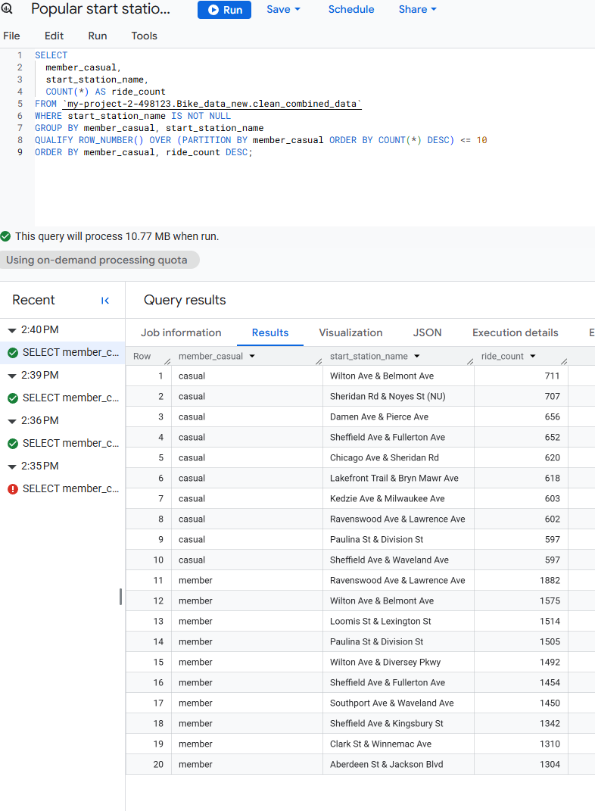
Appendix (Continued)

